Slide 1
Swift Parallel Scripting for High-Performance Workflow
Daniel S. Katz
Assistant Director for Scientific Software & Applications, NCSA
Research Associate Professor, CS
Research Associate Professor, ECE
Research Associate Professor, iSchool
dskatz@illinois.edu, d.katz@ieee.org, @danielskatz

Slide 2
Increasing capabilities in computational science
“Complexity”
Dimensions
Time
Resolution
Error Analysis
Optimization
Coupled (& non-linear) Equations
Components
Ensemble Members
Algorithms
Few Many
1 Many
Simple Complex
No Yes
1 Many
1 2 3
No Yes
Short Long Multiscale
Coarse Fine Adaptive
Domain of Interest
“Time”
programming in the large

Slide 3
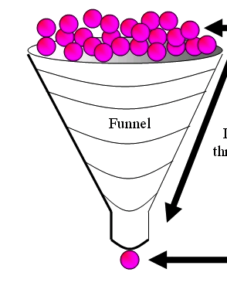
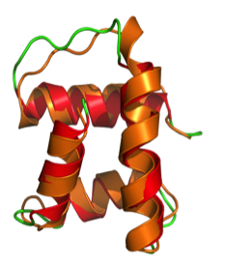
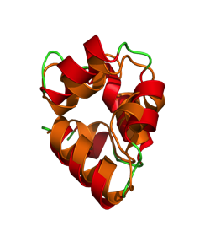
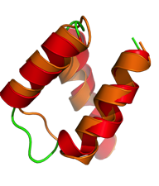
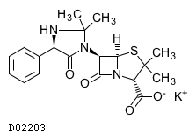
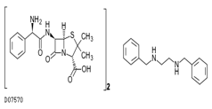
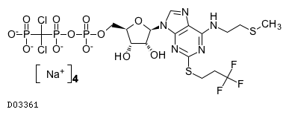

When do you need HPC workflow? Example application: protein-ligand docking for drug screening
O(100K)
drug
candidates
O(10) proteins implicated in a disease
X
…
= 1M
docking
tasks…
…then hundreds of detailed MD models to find
10-20 fruitful
candidates for wetlab & APS crystallography
(B)
Notes:
"docking" is the identification of the low-energy binding modes of a small molecule (ligands) within the active site of a macromolecule (receptor) whose structure is known
A compound that interacts strongly with (i.e. binds) a receptor associated with a disease may inhibit its function and thus act as a drug
Typical Workload:
Application Size: 7MB (static binary)
Static input data: 35MB (binary and ASCII text)
Dynamic input data:10KB (ASCII text)
Output data: 10KB (ASCII text)
Expected execution time: 5~5000 seconds
Parameter space: 1 billion tasks

Slide 4
Expressing this many task workflow in Swift
For protein docking workflow:
foreach p, i in proteins {
foreach c, j in ligands {
(structure[i,j], log[i,j]) =
dock(p, c, minRad, maxRad);
}
scatter_plot = analyze(structure)
To run:
swift –site tukey,blues dock.swift

Slide 5
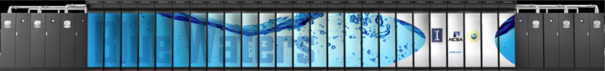




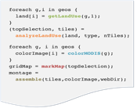



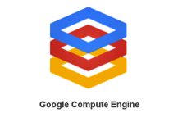


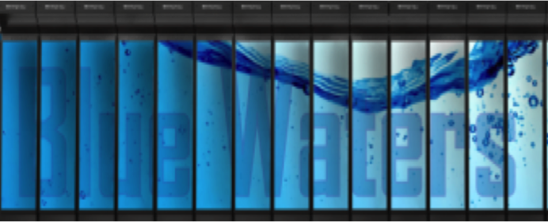
Swift enables execution of simulation campaigns across multiple HPC and cloud resources
Data servers
Data servers
Data servers
Petascale systems
National infrastructure
Scripts
Campus systems
Local data
mark
Apps
Swift host: login node, laptop, …
Cloud resources
The Swift runtime system has drivers and algorithms to efficiently support and aggregate diverse runtime environments
analyze
colorize
analyze
assemble
colorize
analyze
mark
assemble
colorize
apps
analyze
mark
assemble
colorize
apps
analyze
mark
assemble
colorize
apps
mark
assemble
apps
mark
apps
Notes:
5
Swift is a Java ap – untar or module load,and run
Data can be on client or remote (GirdFTP, ) – soon Globus Online.
Overlaps staging and computing wherever possible
Main role is to efficiently run Swift tasks on allocated compute nodes, local and remote
Handles short tasks efficiently without re-scheduling
Runs on distributed infrastructure: Condor, GRAM, AWS
Also runs with few infrastructure dependencies
Can optionally perform data staging
Provisioning can be automatic or external (manually launched or externally scripted)
Dynamically grows and shrinks worker pools
Handles failures through retry and restart

Slide 6
Swift in a nutshell
Data types
string s = “hello world”;
int i = 4;
int A[];
Mapped data types
type image;
image file1<“snapshot.jpg”>;
Mapped functions
app (file o) myapp(file f, int i)
{ mysim "-s" i @f @o; }
Conventional expressions
if (x == 3) {
y = x+2;
s = @strcat(“y: ”, y);
}
Structured data
image A[]<array_mapper…>;
Loops
foreach f,i in A {
B[i] = convert(A[i]);
}
Data flow
analyze(B[0], B[1]);
analyze(B[2], B[3]);
Swift: A language for distributed parallel scripting, J. Parallel Computing, 2011
Notes:
app (file f) predict (Protein seq, Float t, Float dt)
{ psim "-s" @seq.fasta "-pdb" @p ; }

Slide 7
Pervasively parallel
(int r) myproc (int i)
{
int f = F(i);
int g = G(i);
r = f + g;
}
F() and G() are computed in parallel
Can be Swift functions, or leaf tasks (executables or scripts in shell, python, R, Octave, MATLAB, ...)
r computed when they are done
This parallelism is automatic
Works recursively throughout the program’s call graph

Slide 8
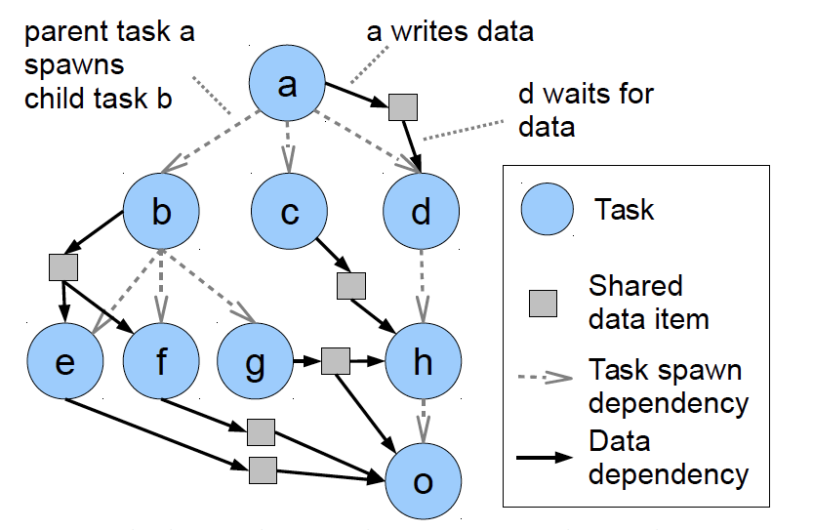
Pervasive parallel data flow

Slide 9



Swift/T: productive extreme-scale scripting
Swift worker process
Parallel evaluator and data store
Swift worker process
Swift control process
Swift worker process
Swift control process
MPI
Scripts
C
C++
Fortran
C
C++
Fortran
C
C++
Fortran
Script-like programming with “leaf” tasks
In-memory function calls in C++, Fortran, Python, R, … passing in-memory objects
More expressive than master-worker for “programming in the large”
Leaf tasks can be MPI programs, etc. Can be separate processes if OS permits.
Distributed, scalable runtime manages tasks, load balancing, data movement
User function calls to external code run on thousands of worker nodes
Notes:
Task data can be
in-memory objects
file stored on disk

Slide 10
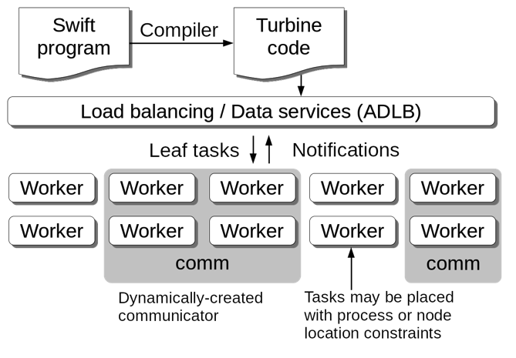
Parallel tasks in Swift/T
Swift expression: z = @par=8 f(x,y);
ADLB server finds 8 available workers
Workers receive ranks from ADLB server
Performs comm = MPI_Comm_create_group()
Workers perform f(x,y)communicating on comm
Notes:
Task data can be
in-memory objects stored in ADLB
file stored on disk, file vars in ADLB
Files can be stored in shared disk, or locally using MosaStore, Hercules, etc.

Slide 11
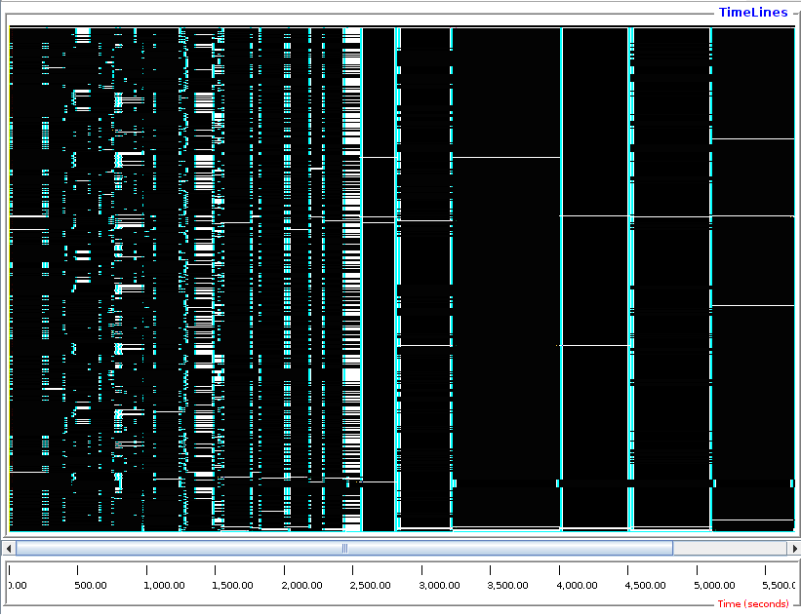
LAMMPS parallel tasks
foreach i in [0:20] {
t = 300+i;
sed_command = sprintf("s/_TEMPERATURE_/%i/g", t);
lammps_file_name = sprintf("input-%i.inp", t);
lammps_args = "-i " + lammps_file_name;
file lammps_input<lammps_file_name> =
sed(filter, sed_command) =>
@par=8 lammps(lammps_args);
}
LAMMPS provides a convenient C++ API
Easily used by Swift/T parallel tasks
Tasks with varying sizes packed into big MPI run. Black: Compute Blue: Message White: Idle

Slide 12
Swift/T-specific features
Task locality: Ability to send a task to a process
Allows for big data –type applications
Allows for stateful objects to remain resident in the workflow
location L = find_data(D); int y = @location=L f(D, x);
Data broadcast
Task priorities: Ability to set task priority
Useful for tweaking load balancing
Updateable variables
Allow data to be modified after its initial write
Consumer tasks may receive original or updated values when they emerge from the work queue
Wozniak et al. Language features for scalable distributed-memory dataflow computing. Proc. Dataflow Execution Models at PACT, 2014.

Slide 13
Swift/T: scaling of trivial foreach { } loop 100 microsecond to 10 millisecond tasks on up to 512K integer cores of Blue Waters

Slide 14
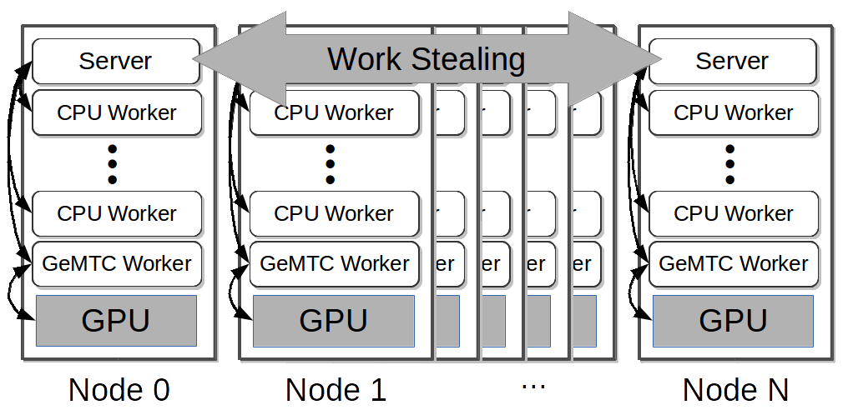
GeMTC: GPU-enabled Many-Task Computing
Motivation: Support for MTC on all accelerators!
Goals:
1) MTC support 2) Programmability
3) Efficiency 4) MPMD on SIMD
5) Increase concurrency to warp level
Approach:
Design & implement GeMTC middleware:
1) Manages GPU 2) Spread host/device
3) Workflow system integration (Swift/T)
S. J. Krieder, J. M. Wozniak, T. Armstrong, M. Wilde, D. S. Katz, B. Grimmer, I. T. Foster, I. Raicu, "Design and Evaluation of the GeMTC Framework for GPU-enabled Many-Task Computing,” HPDC'14

Slide 15
More about Swift
http://swift-lang.org
Includes a couple of running VMs where you can try it out
See “Try Swift Online”

